Slide 1






PocketPaw Co
YOUR PET IN YOUR POCKET

Slide 2
Our team
David Pérez
Federico
Falcone
Guillem
Escriba
Oriol Soler
CEO
CFO
CEO
GENERAL MANAGER
Data Science Engineer
Computer Engineer
Data Science Engineer
Audiovisual Engineer

Slide 3
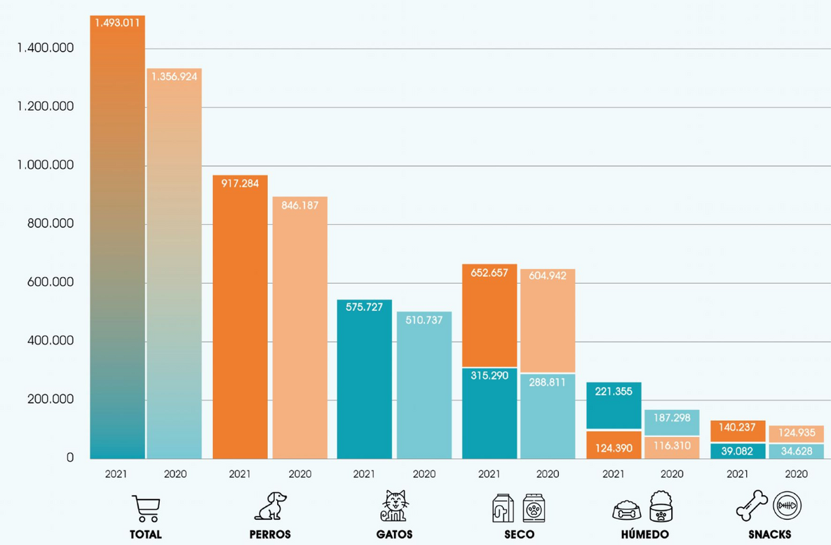
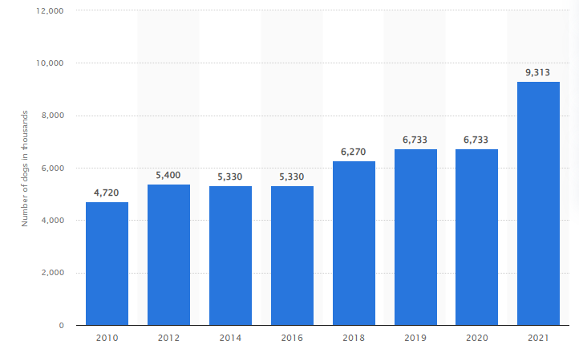
INTRODUCTION
Dog Population in Spain 2010-2021
Billing in numbers (M€)
Statista
Anfaac

Slide 4
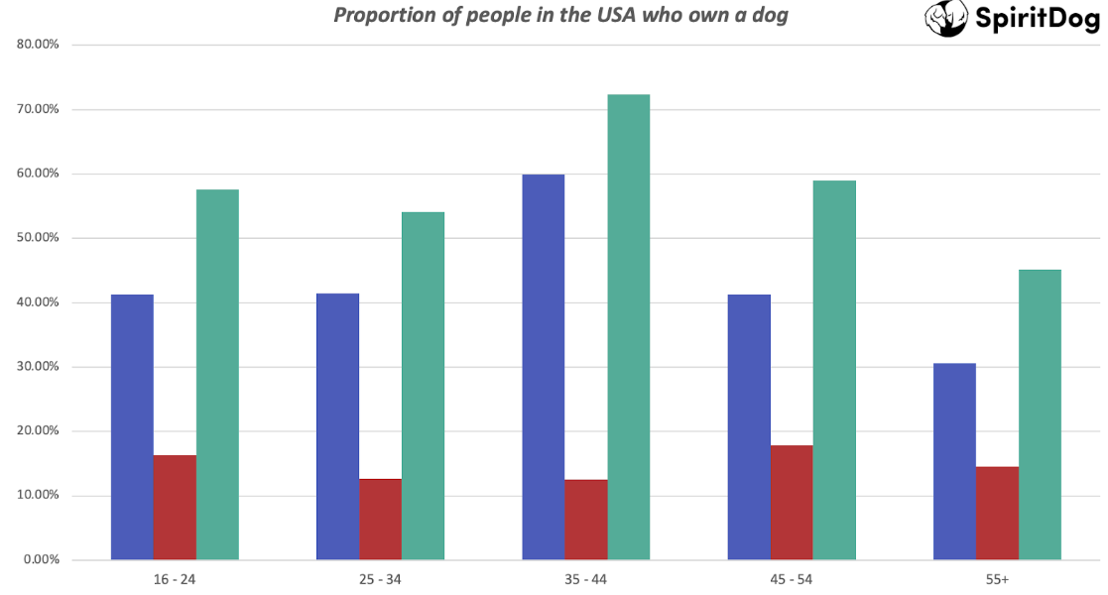
IDENTIFICATION OF NEEDS
95% Spanish men younger than 30 have NO kids for a 80% of women (INE).
"Connected Generation"
138.000 abandoned dogs on 2018 (Affinity Foundation.)

Slide 5
PocketPaw: Pet Care All in a Single Platform

Slide 6
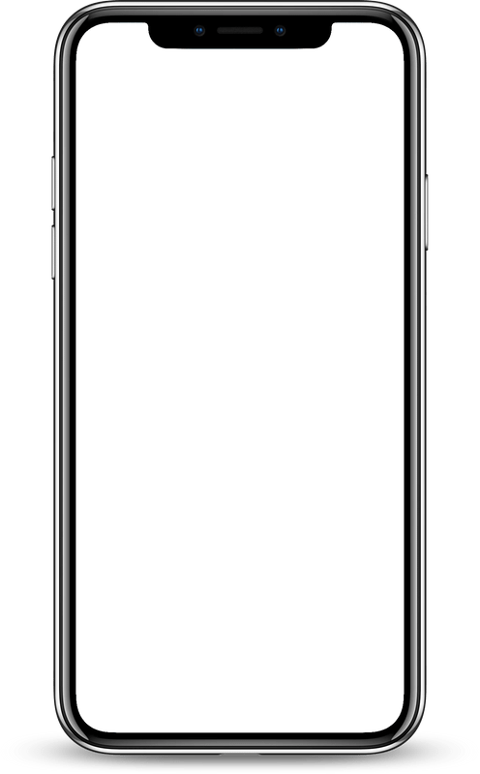


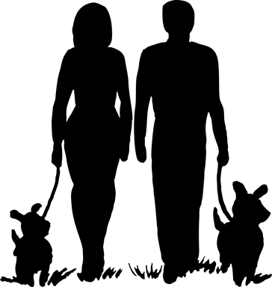

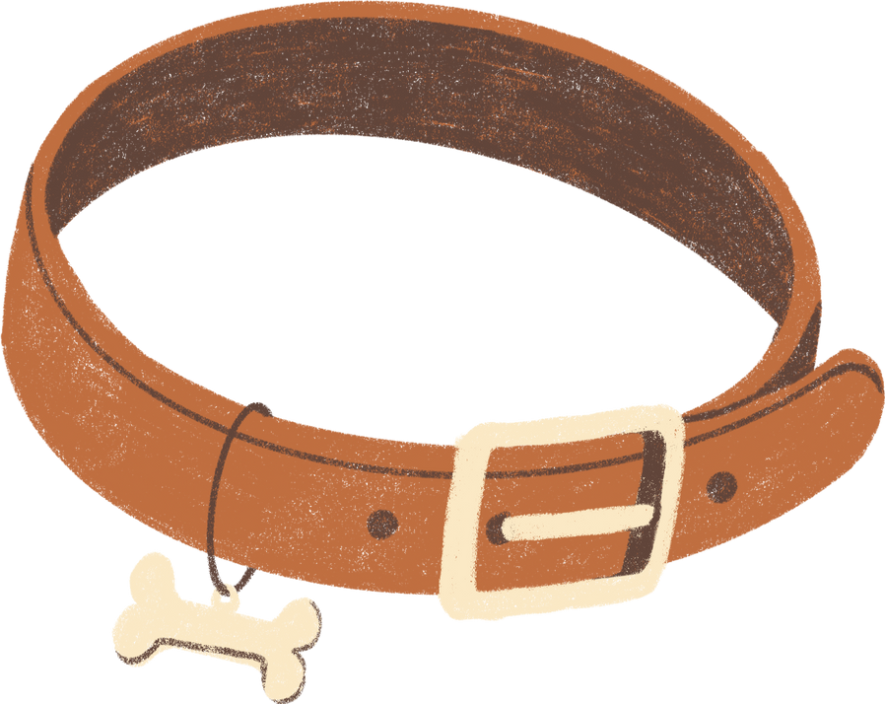





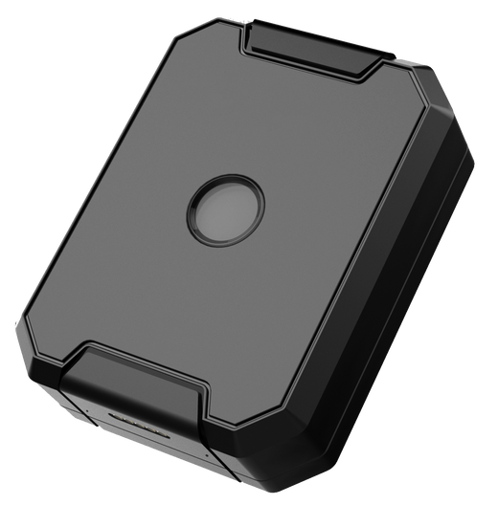





Whole Eco-system
Satisfaction
Activity
Tracking
Pet tracking results:
Pet profile
Select a location to obtain more information about it.
Reminders and schedules
GPS tracking
PRO
Medical records
Social community
List of tracked pets:
List of tracked pets:
PRO
PRO
Ease of use
Innovation

Slide 7





POCKETPAW SERVICES
PocketPaw Version
Basic
PRO
Free
With ads
Activity tracking
Reminders and medication schedules
Pet profile creation
Specialist Guides and Tips
GPS tracking
Vet affiliation and scheduling
Social community
Medical records

Slide 8


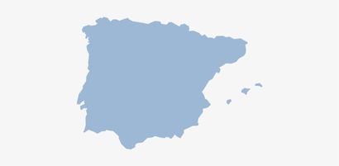





Segmentation: Target Market
01
Half the population have pets
AGE
BUDGET
in Spain and Portugal, where our distributors have stores.
30M
02
Young people hog the internet
Youngers than 50 are the 80% of the common Web-App users.
20M
03
Evenly distributed by gender
56% of women have pets for 53% of men, so no segmentation about gender is done.
20M
€ € €
No differentiation by budget
Pet owners spend an average of 400€ a year in pet care, our affordable pricing is not gonna take them back
20M
One download per home App
Our App and services are thought to be used by a family unit, which in Spain is about 4 people in average.
5M

Slide 9







Communication & Distribution channels
Social advertising
Influencer marketing
PocketPaw APP:
PocketPaw app is available at the most important app stores:
PocketPaw Products:
Our products can be obtained in the well-known pet shops KIWOKO with physical and online stores.
Sponsorships
Educational content
+140
stores
Mail marketing

Slide 10
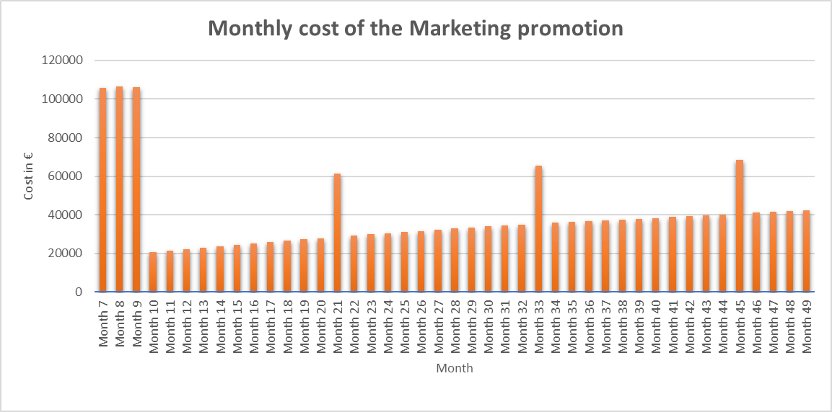
How to reach them?
Initial Campaign
1st Anniversary update campaign
2nd Anniversary update campaign
3rd Anniversary update campaign

Slide 11

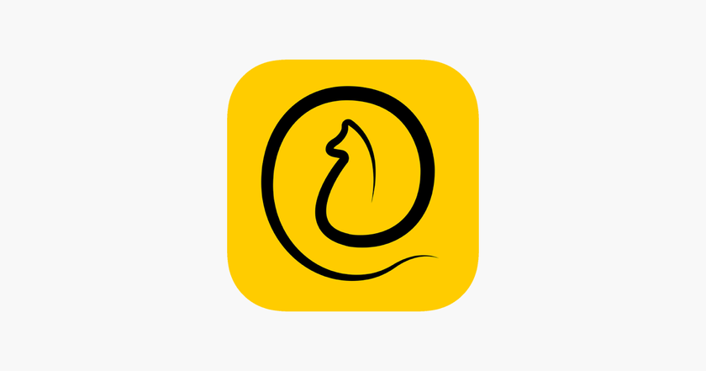




ANALYSIS OF THE COMPETITORS
Differentiation:
Differentiation:
Differentiation:
Differentiation:
So many small competitors.
So many competitors of our GPS offer.
Competitive pricing.
Competitive advantage:
-> Kiwoko distribution,
-> All features from competitors in one app + unique features.
11pets - All-in-One
Puppr - Best Training
Rover - Dog sitters
Tractive- Tracking
500.000
1.000.000
1.000.000
100.000
Competitive Advantage: Lower price
Competitive Advantage: Specialized service
Competitive Advantage: Biggest market share
Competitive Advantage: Most precise tracking
Tractive- Annual Revenue in 2022: $36M
11pets - Annual Revenue in 2022: $1.0M - $2.0M
Rover - Annual Revenue in 2022: $0.16 B

Slide 12

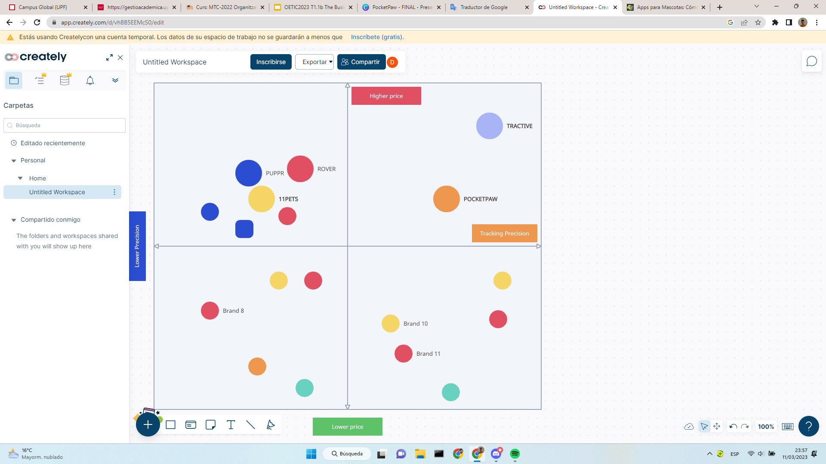
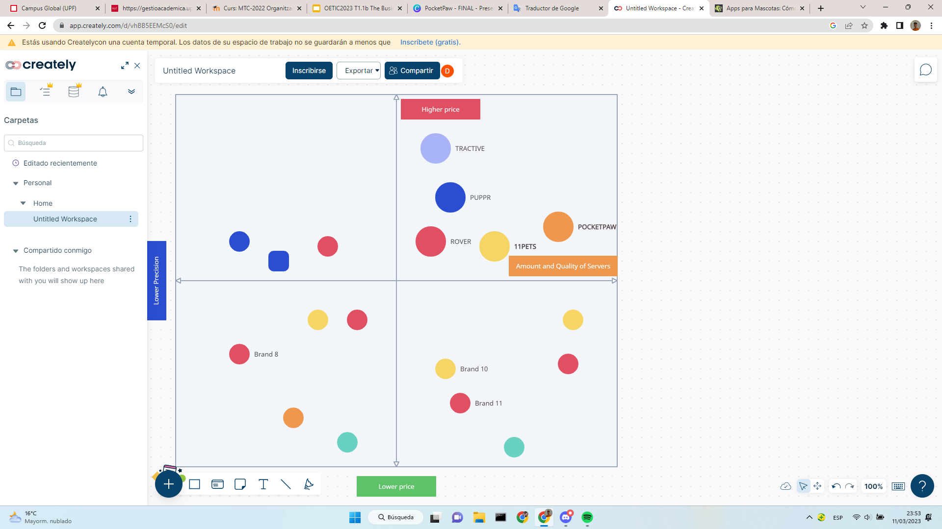
Positioning
TRACKING DEVICES
TOTAL SERVICES VALUE

Slide 13




Sector attractiveness analysis:
CUSTOMERS
SUPPLIERS
Debilidades
Growing market: 29 million pets in Spain
Most are not informed about these tools
Easy to switch apps.
High amount of suppliers
Easy change of suppliers
COMPETITORS
A lot of competitors
No big competitor
Differentiation
Easy entry to the market
Low investment
Established competitors
Replacable features
Unique as a whole
NEW COMPETITORS
SUBSTITUTES

Slide 14





PocketPaw Co: Development Stages
WEB CREATION
COMPANY CREATION
APP DEVELOPMENT
TESTING THE ENVIRONMENT
LAUNCHMENT AND PROMOTION
PRODUCT CREATION
1 Year
STAGE 0: COMPANY CREATION (MONTH 1)
STAGE 1: APP, WEB AND PRODUCT DEVELOPMENT (MONTHS 2-5)
STAGE 2: TESTING THE ENVIRONMENT (MONTHS 6-8)
STAGE 3: LAUNCHMENT AND PROMOTION (MONTHS 9-12)
The first step is creating the company after that we need to define the idea while we outsource a external market study.
After the development of the Web, App and the Product, and making several tests and corrections, we need to test the whole environment.
Social Media promotion and first releases of BETA versions of the product to get feedback and do the final corrections.
We will create three parallel development teams, one for each feature of the environment. The Web Creation will be outsourced.

Slide 15
Legend
Activity plan
Marketing Team
Outsourcing
Product Dev Team
PocketPaw Co.
Web Dev Team
Task
Month 1
Month 6
Month 7
Month 8
Week 1
Week 2
Week 3
Week 4
Task
21
22
23
24
25
26
27
28
29
30
31
32
Company Creation
Documentation
Testing web services
Brainstorming
Web corrections
Defining the idea
Market Study
Interaction APP-Web
Creating the teams
SEO Web
Funding
Testing GPS features
Month 2
Month 3
Month 4
Month 5
Final corrections
Task
5
6
7
8
9
10
11
12
13
14
15
16
17
18
19
20
APP: Design and mockup
Month 9
Month 10
Month 11
Month 12
APP: Software programming
Task
APP: UI programming
33
34
35
36
37
38
39
40
41
42
43
44
45
46
47
48
APP: Combine software + UI
APP: Testing
Vet collaboration
APP: Social Media Forum
Web: Search Web developers
KIWOKO promotion
Web: Design and mockup
Web: Creation
Social media campaign
Web: Testing
Release BETA
Product: Design
Product: Prototyping
Final corrections
Product: Providers
Product: Testing
Final release
Product: Distributors KIWOKO

Slide 16





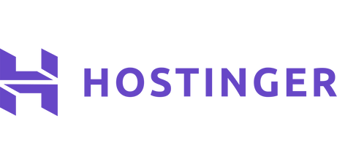


Legend
Where's our value?
Outsourcing
PocketPaw Co
Key Areas
Market research
Purchase device orders
Marketing and Sales
Delivery
After Sales Support
Customer Feedback and Analysis
Update Virtual Services
Registration on servers
App Download
Market Study
Web Maintenance
We trust in the best specialized companies for outsourcing each one of the key stages that add value for our customers.
This do not only assures the well functioning of all our process, but makes us more reliable for our potential customers and investors, since some of our main procedures are taken by the some of the most well-known companies in their field.

Slide 17

Organizational chart
GENERAL DIRECTION
BUSINESS DEVELOPMENT
[1]
OPERATIONS
[1]
ADMINISTRATION
[1]
TECH
[1]
MARKETING
[7]
SALES
[4]
PURCHASING & PRODUCTION
[1.5]
LOGISTIC
[0.5]
AFTER SALES
[2]
FINANCE GA
[2]
HUMAN RESOURCES
[3]
PRODUCT UPDATING
[11]
Key departments
Since we are in a very competitive market with some apps that have similar functions we need a powerful marketing department to diferentiate us. Also to remain in the market we need to constantly update the product to compete against our rivals.

Slide 18
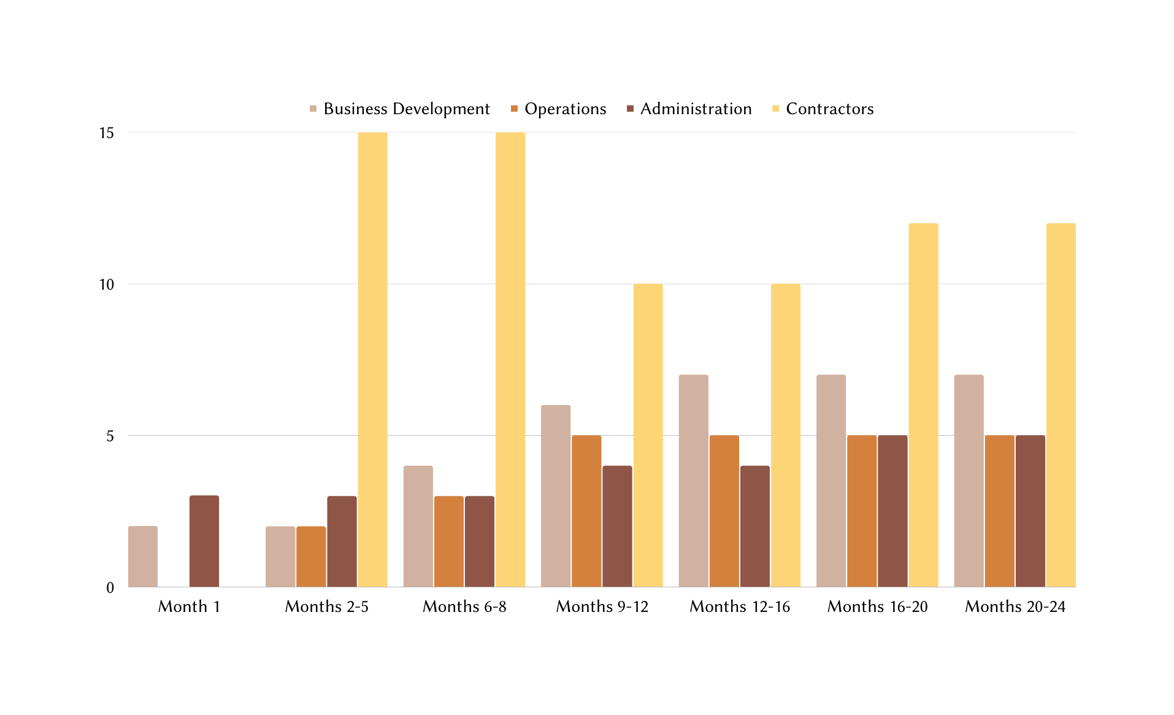
Company growth
Tech
FTE (headcount + contractors)
Company Creation
Development
Testing
Final Release
Corrections
Possible Updates
Time

Slide 19



Internal
External
S
W
O
T
Strength
Weakness
Recurring revenue
High competition
The app offers paid features such as premium analytics or advanced tracking, the company could generate recurring revenue from users
The pet care app market has already a few competitiors that already have a loyal user base
Many services in one place
Dependence on the internet
This service offer and group a vast list of functionalities and everyone of them can be easily accessed in the same place
In order to work properly in every functionality, this application needs the device to be connected on the internet
Good Placement and Distribution
GPS easily replacable
Thanks to our partnership with Kiwoko, our distribution is gonna lead us closer to the users than any other competitor.
We are aware that the main feature from our PRO version could be less profitable as we expect, since it is now really easy to find anywhere.

Slide 20


Internal
External
S
W
O
T
Opportunities
Threats
New home era
Why is it not already happening?
Each one of our expectations make us happen, if the market already exists, why this idea is not already succeding?
After the pandemic situation most of the daily tasks are now done in home, such as telecommuting, this entails a tendency of having more pets.
Economic downturn
A recession could result in decreased spending on non-essential items such as pet care apps
Accessible market for everyone
Data Securtity concerns
The percetnage of the population dependence on the internet is growing as the amount of people adapted to the net, which makes our services easier to use for any kind of people with pets.
We constantly deal with sensible users data (GPS tracking for example) we have to prevent any potential risk that can compromise the confidentiality, integrity, or availability of them

Slide 21
PocketPaw: Finances
OVERVIEW:
Revenues: how much money will we earn?
Expenses: where will the money go?
Income Statement and Cashflow forecast
Scenarios: optimistic and pesimistic
Funding: how much money are we requesting?

Slide 22
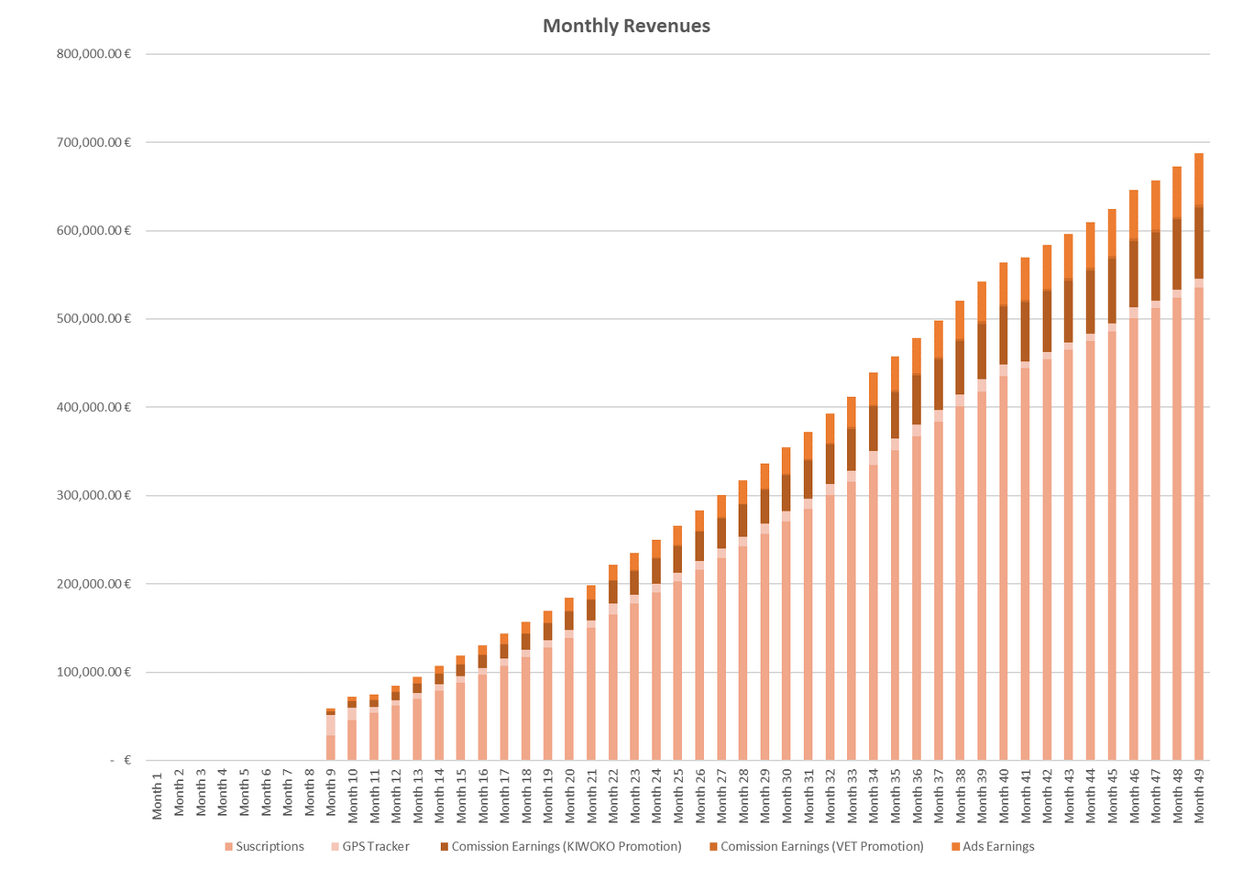
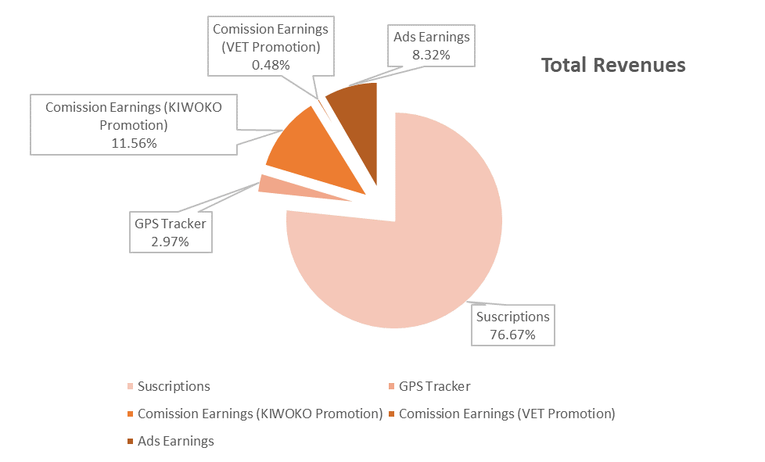
REVENUES
Total revenues
during the period:
14,500,000€

Slide 23
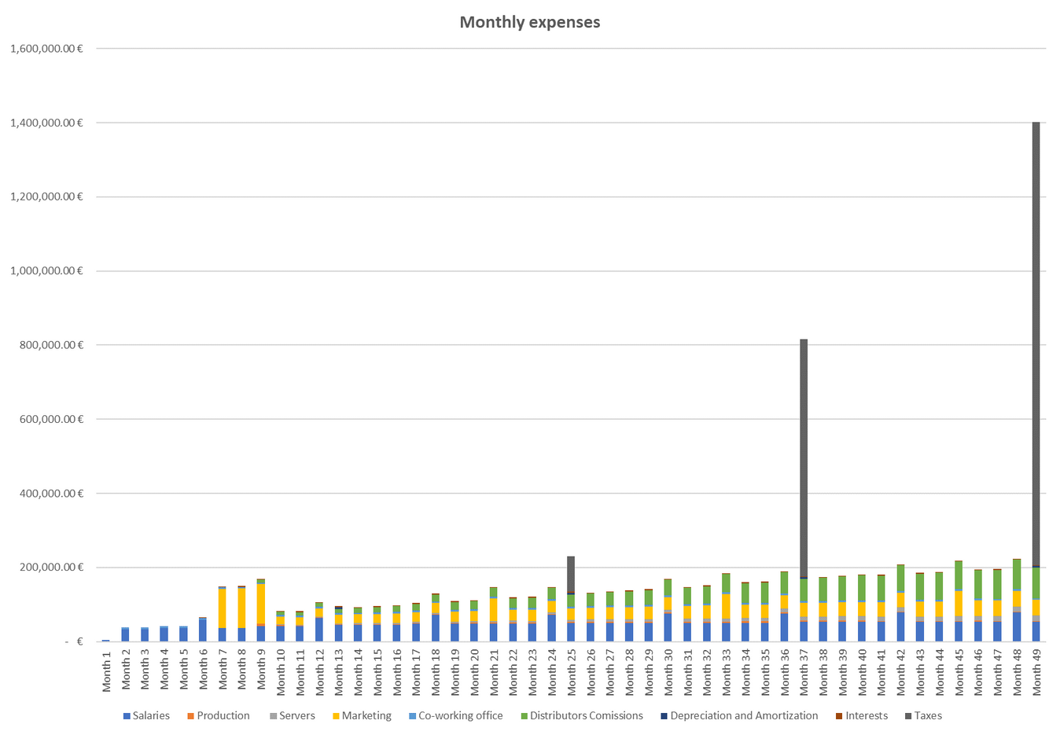
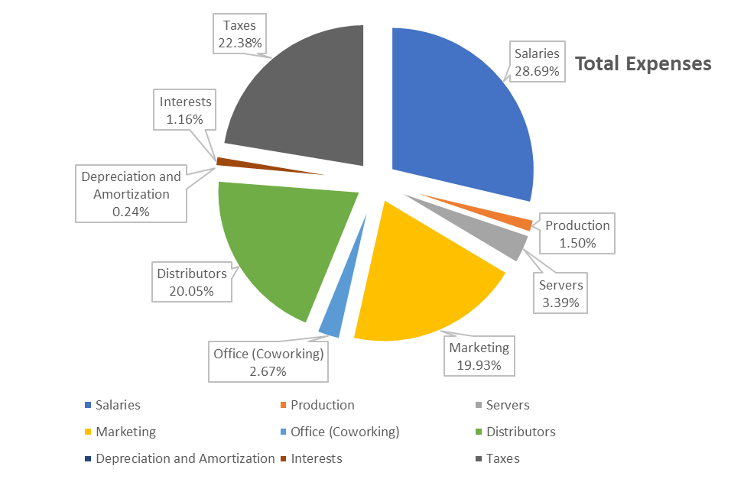
EXPENSES
Total expenses
during the period:
8,600,000€

Slide 24
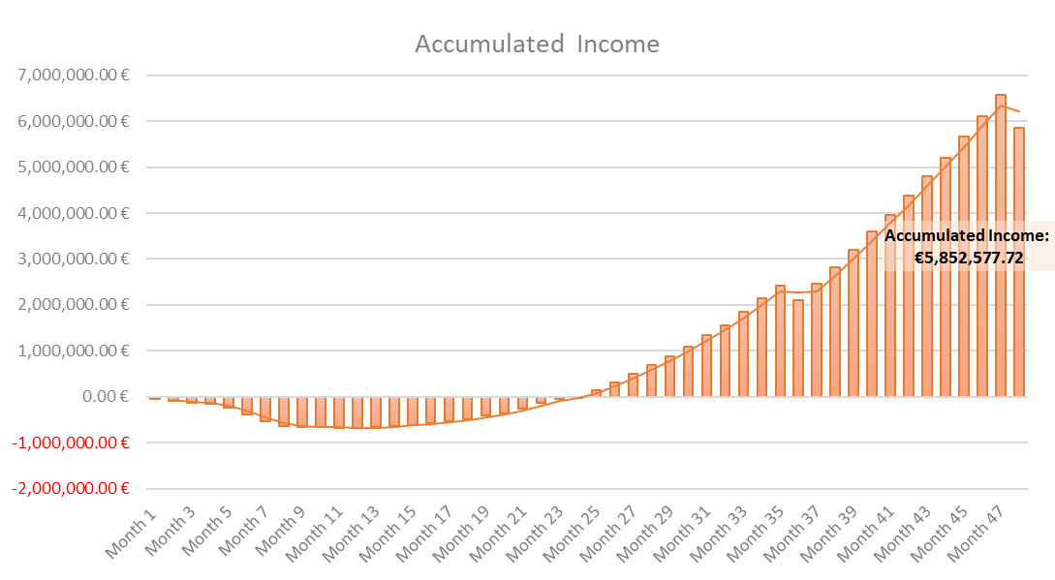
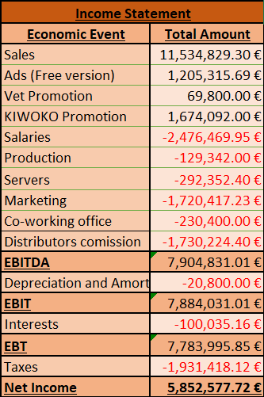
Income Statement BreakDown

Slide 25
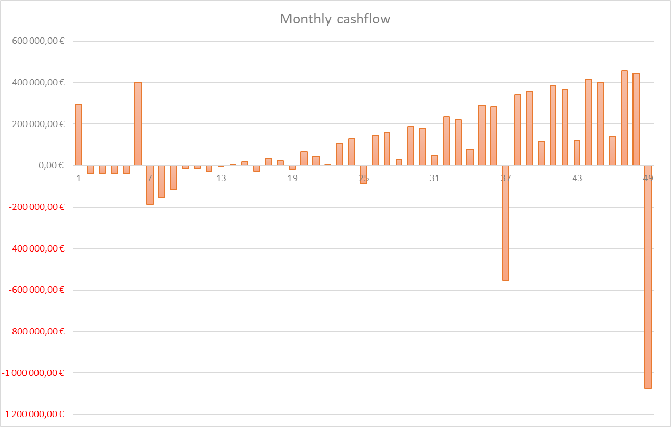
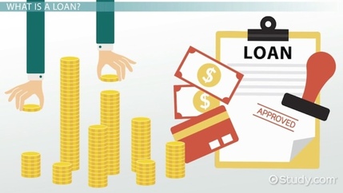

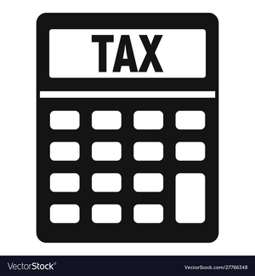
FORECAST OF CASHFLOW(4 YEARS)

Slide 26
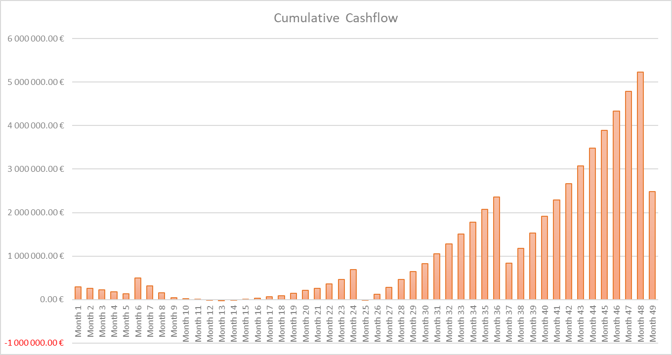
FORECAST OF CASHFLOW(4 YEARS)

Slide 27
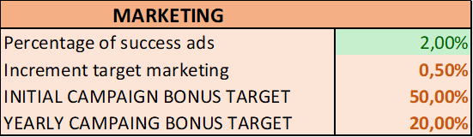
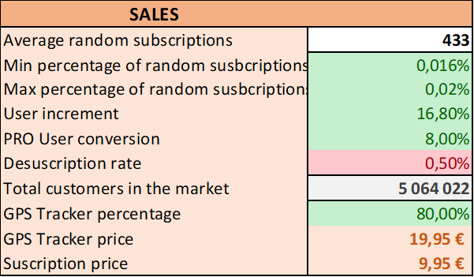
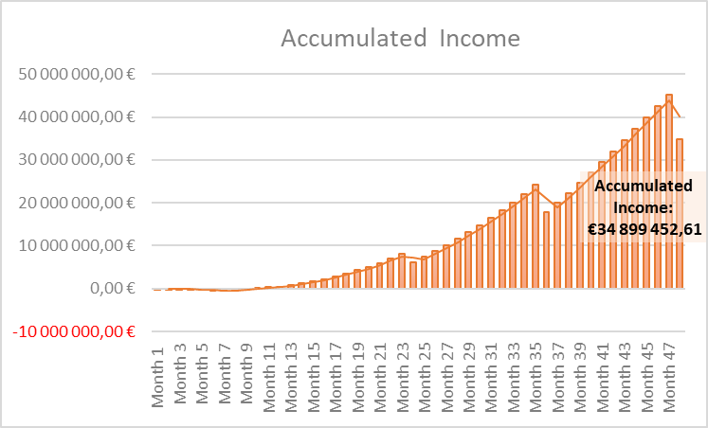
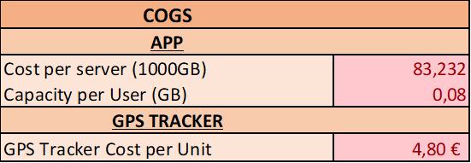
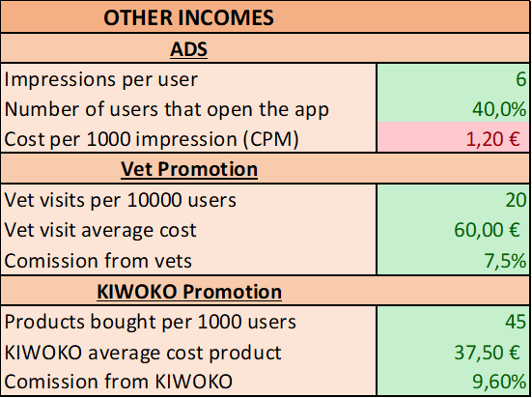
SCENARIOS - BEST CASE

Slide 28
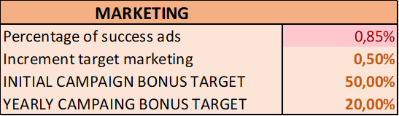
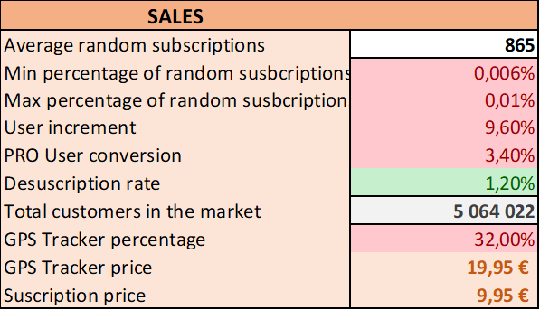
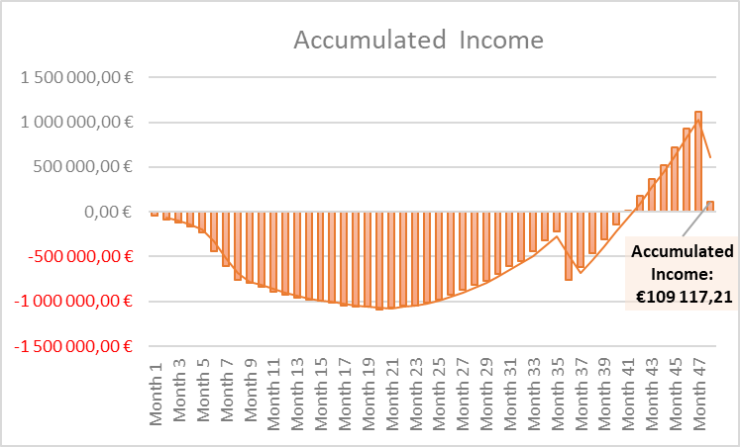
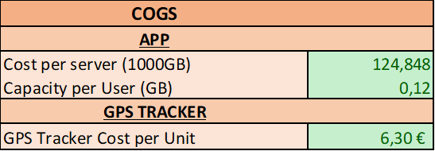
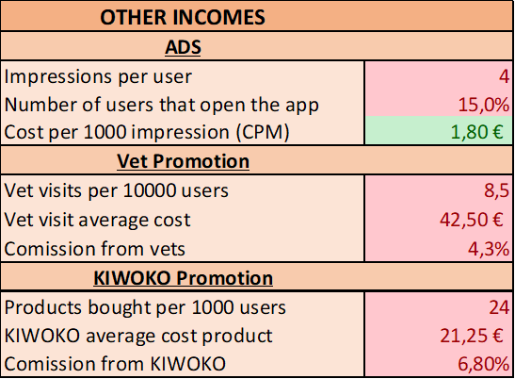
SCENARIOS - WORST CASE

Slide 29
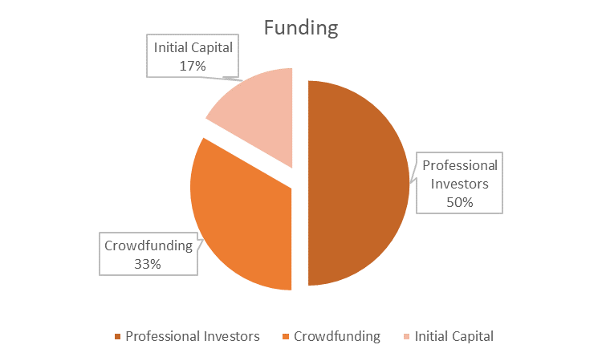
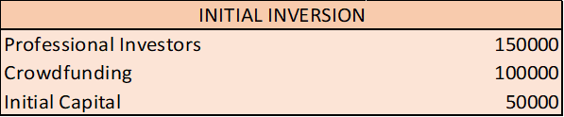
How much money do we need?
With this amount we are able to start operating as a company at the start.
If we need more money, there are special loans provided by the government like "Jóvenes Emprendedores" with a very low interest and high return period.

Slide 30
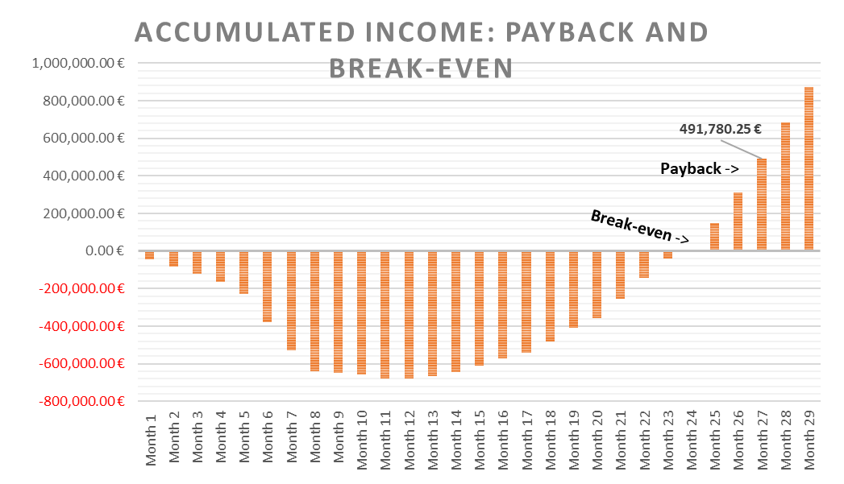
Investment recovery:
REALISTIC
Break-even:
Month 25
Month 27
Payback:
PESIMISTIC
Break-even:
Month 39
Month 43
Payback:
OPTIMISTIC
Break-even:
Month 11
Month 11
Payback:
Note: Since we have several sources of revenues is hard to compute the break-even as amount of units sold so we compute it as the month where we have enough revenues to become positive, which is the same but in terms of time. If we only use suscriptions the break-even (in units) will be approximately: 80,400 subscriptions (1 month subscription)

Slide 31

Thanks for your attention!
EMAIL | WEBSITE | SOCIALS
info@pocketpaw.com | www.pocketpaw.com | @pocketpaw

Slide 32
BACKUP SLIDES
BACKUP SLIDES

Slide 33
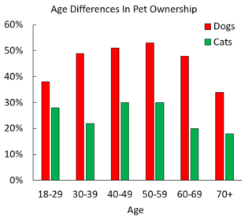
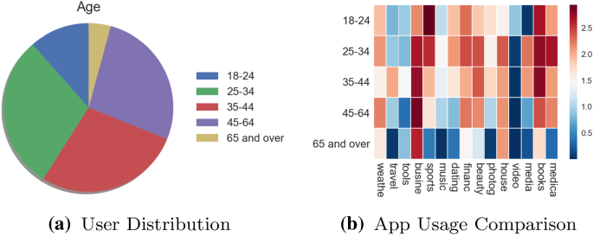
Why this segmentation?
BACKUP SLIDES
NO POSSIBLE AGE SEGMENTATION
OLDER PEOPLE ARE FAR AWAY
Evenly distributed by age
Our data about pet owners tell us that there is no relevant difference on the age of them, since even the people older than 70 is close to the rest of the owners, so any segmentation in this was will make the difference.
The youngest conquer the internet
Here we do see an important pattern for our segmentation. The 80% of the apps users are younger than 45 years old, which shows us that our product may be more difficult to adapt in the older section of our potential customers.

Slide 34
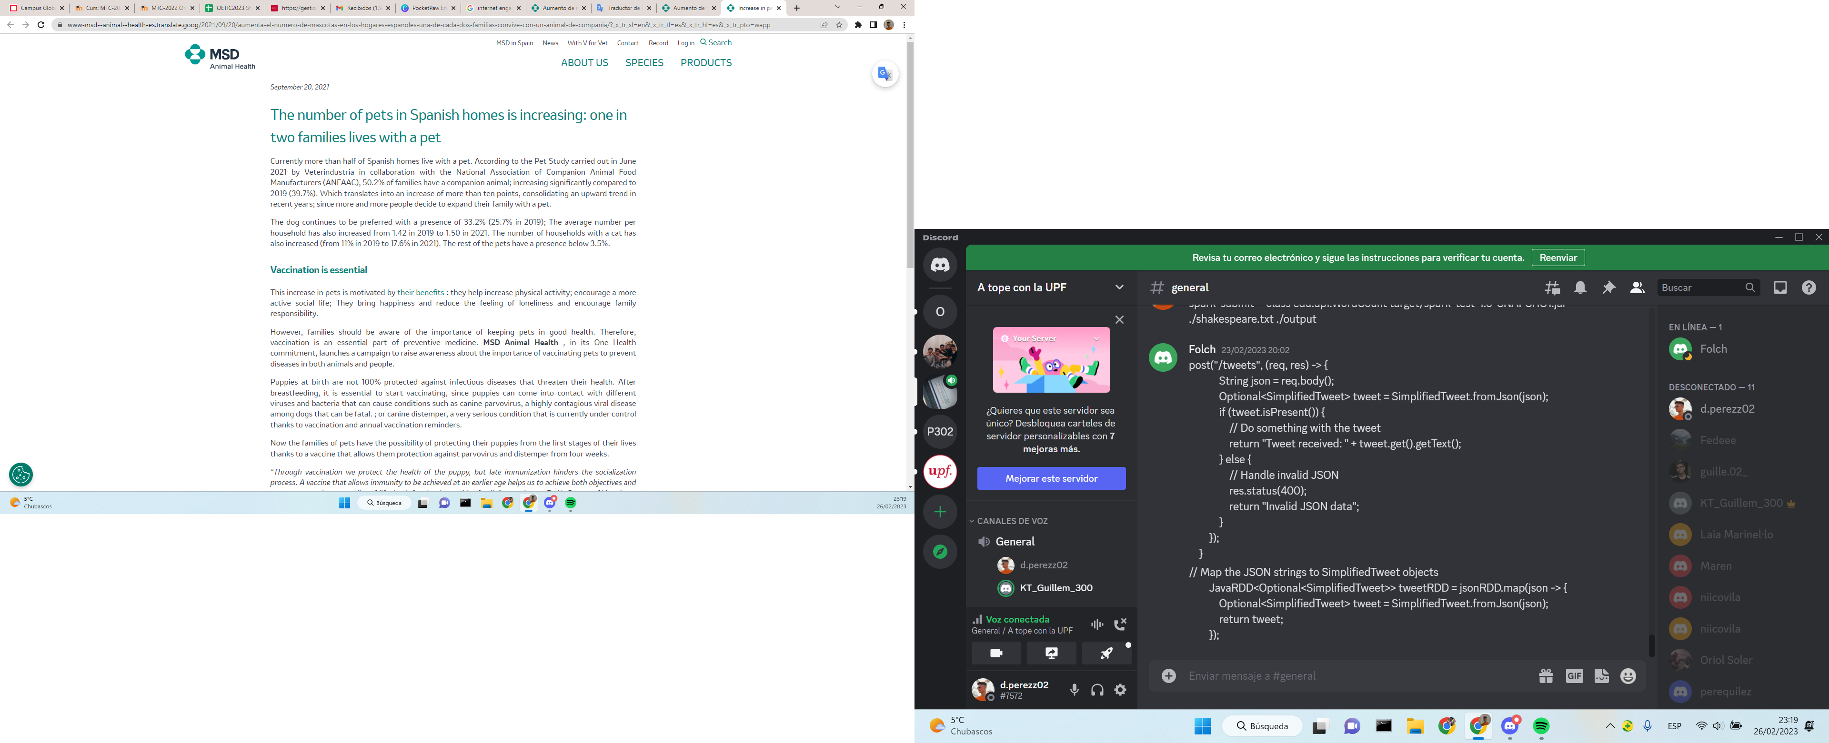
Pet Care Sector in Data:
BACKUP SLIDES
Half of Spanish households have pets, according to MSD Animal Health.

Slide 35
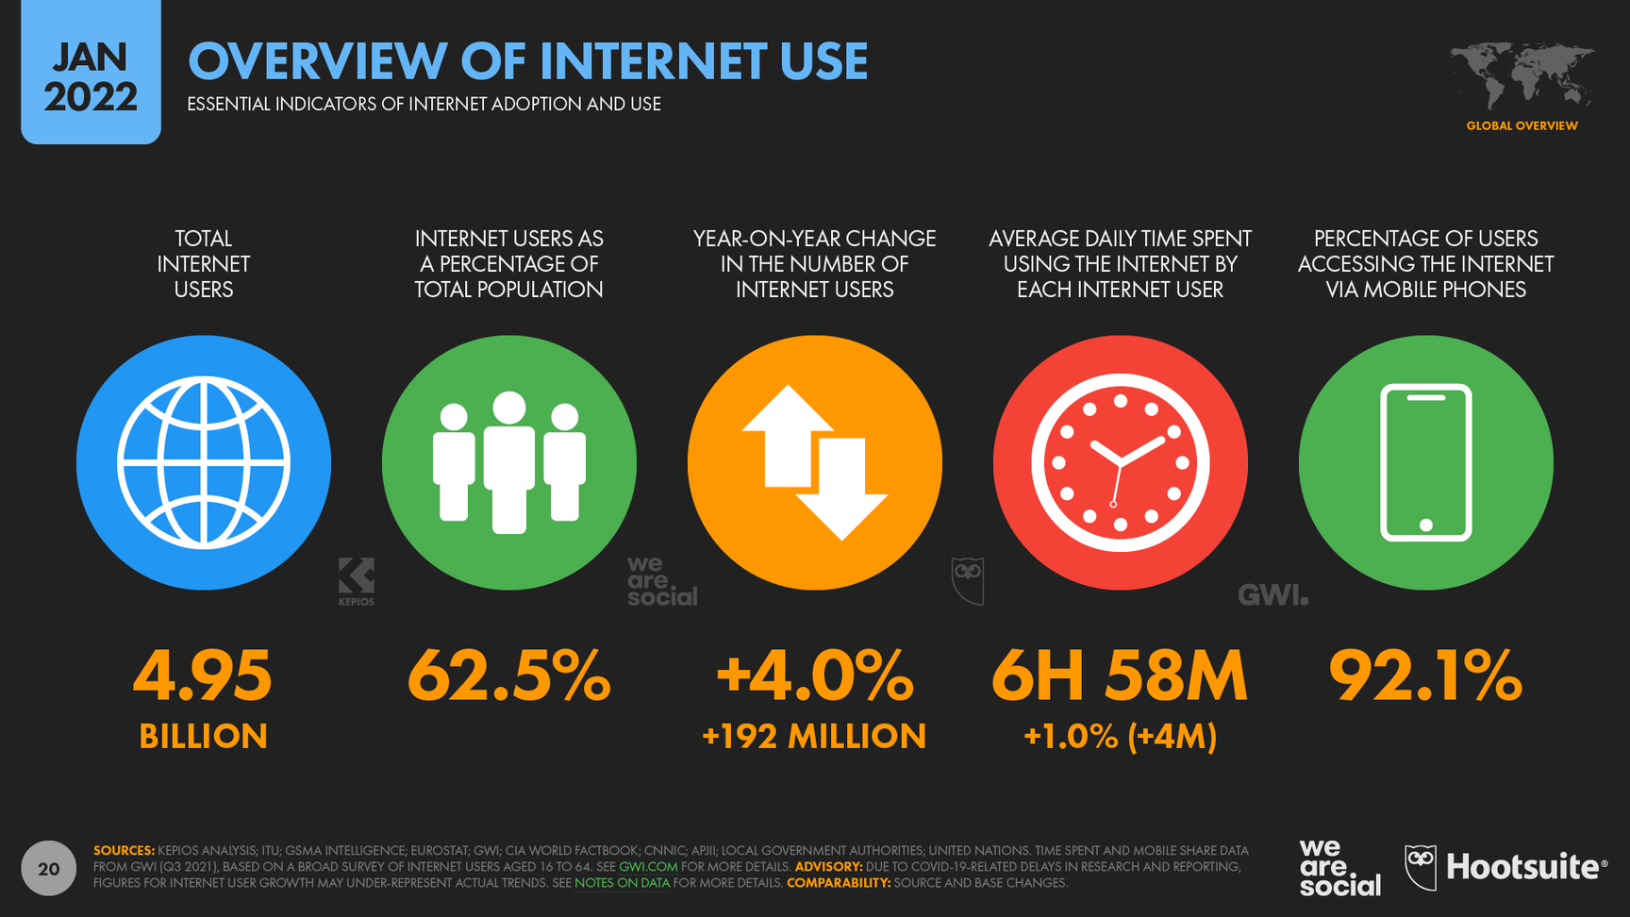
Pet Care Sector in Data:
BACKUP SLIDES
More internet engagement trough years leads to more potential users.
Common internet and apps users see with better eyes new apps about monitoring the data of their belongings, like PocketPaw.
NEW COMPETITORS
SUBSTITUTES

Slide 36
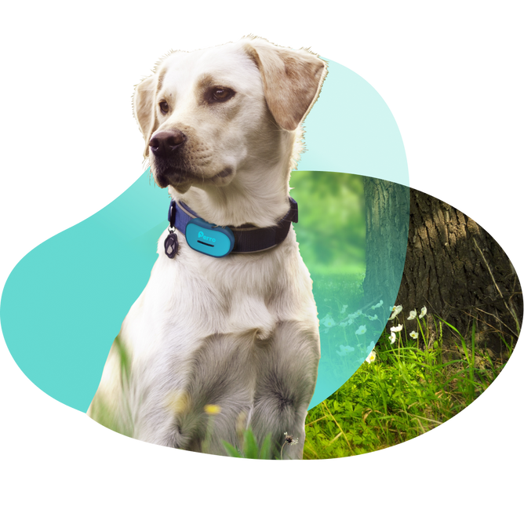

SUBSTITUTE PRODUCTS
We offer a unique value proposition by combining the most useful pet services.
Social media platform value.
Powerful collaboration with KIWOKO.
Some features can be easily individually substituted.
-> Traditional methods
-> Cheap GPS everywhere
BACKUP SLIDES

Slide 37
Techology insertion in pet care
Bring people closer to their pets
Help people with their first pets
High influence of tracking technology in global economy.
Support useful investment in pet care.
SOCIO-CULTURAL
ECONOMIC
BACKUP SLIDES
All the data about your pet in your phone.
Thanks to huge social media we provide a greater common knowledge.
Protect the users privacy.
Follow EU general data protection regulation
Enforce the animal care law enforcement
LEGAL
TECHNOLOGICAL

Slide 38

Value pyramid
By monitoring their activities and health, owners enhances their emotional bond between them and their pets, and promotes a sense of responsibility and commitment towards them
Social
BACKUP SLIDES
Collecting sensitive personal data such as location and health information is one of the most critical legal value. We must comply with relevant privacy laws such as the GDPR and implement appropriate security measures to safeguard user data
Protection
Providing easy accessibility of pet data through a mobile app can save pet owners time and effort, while the platform can facilitate the sharing of knowledge and experiences related to pet care, enabling pet owners to learn from one another
Technology
The app represents an investment in this growing market, providing a valuable tool that can help pet owners to better care for their pets and promote responsible pet ownership
Economic & Pricing

Slide 39
Q&A
Do you intend to fire half of the staff when you reduce the department staff?
+ No, since while our business development department is going to have less demand, our other departments are going to increase their size at the same time our company growth, so our plan is to change their role in the company as it would be so flexible in that periods.
How can you remove Tech departments if your company is about an app/web?
+ Actually, we are not removing any department. We are initially setting up two tech departments, in order to develop both the web/app services and the GPS device, which needs professional experts, but after they are designed and created in the initial stage of the company, we are not gonna need that process anymore, and our tech department is only gonna focus in I+D and updating the current application and web services, as well as the GPS device, so both original subsections are going to work, with obviously less demand, on the product updating. About tech department we made the decision during the development stage to hire some engineer contractors temporarily to accelerate that process.
BACKUP SLIDES

Slide 40
Q&A
How are you going to deal with malfunctioning products?
+ Since our production is completely outosurced, and what we car the most is our customers satisfaction, in case there is any kind of problem with an exemplar of our product the customer is gonna be able to inmediately contact with us about that, with the after sales support team, and they are going to manage a devolution of the malfunctioning product and a second delivery of a new one, in order to prioritize a quick solution of a user inconvenience. After that we are going to send the malfunctioning product back to our outsourced company, with who our production staff responsible of managing the control of quality is gonna deal in order to get a new one or get it fixed, as well as providing us with an analyisis of the problem and the possible consequences in further anomalies.
BACKUP SLIDES

Slide 41
Q&A
Why are you not having any subdepartment in Administration and Operations?
+At the beginning of the company, we are going to need some especializations in our staff, such as the engineers and the marketing people, but we do not need that specification in other general sections, like the operations and administration, since at the beginning of start-ups there is always a lot of self-organization. Moreover, we must emphasize that we are outsourcing the manufacturing of our phyisical product, the GPS, so the needed staff is reduced in the operations section, as well as in the organization one, since we are also outsourcing the human resources area only in the beginning of the company, to let the selection of our engineers, the key of our project, in the hands of professionals.
BACKUP SLIDES

Slide 42
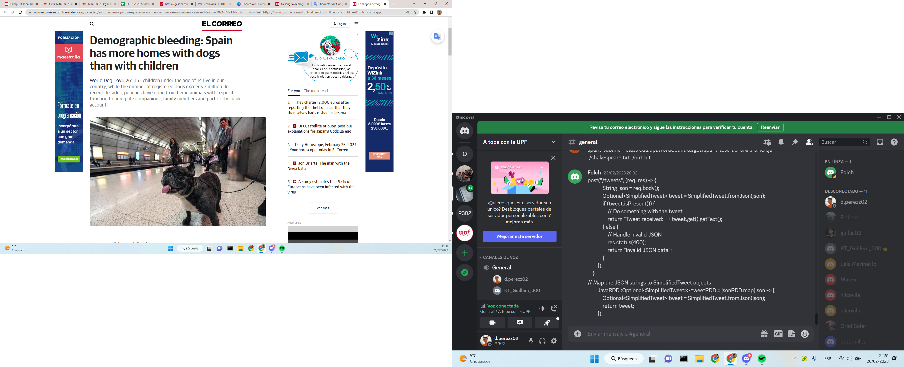
BACK UP SLIDES
New spanish lifestyle: Adults prefer pets rather than children.
All of this helps the faster growing of the market in the post-pandemic years.
BACKUP SLIDES
Spanish newspaper - EL CORREO, July 2021

Slide 43
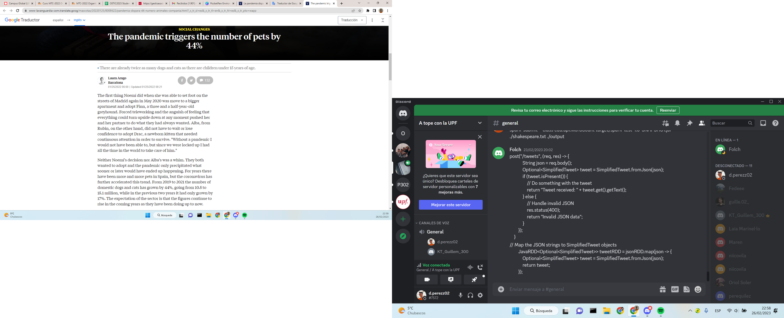
BACK UP SLIDES: The Pandemic effect
More data about the pandemic effect on the spanish people tendency about pets, now from La Vanguardia, one of the most important newspapers in Spain.
After the pandemic, the number of pets increased by 44%. After, not only during, since it lead to a new lifestyle closer to home, and this is still present in the most part of the society.
BACKUP SLIDES
Spanish newspaper - LA VANGUARDIA, January 2022

Slide 44
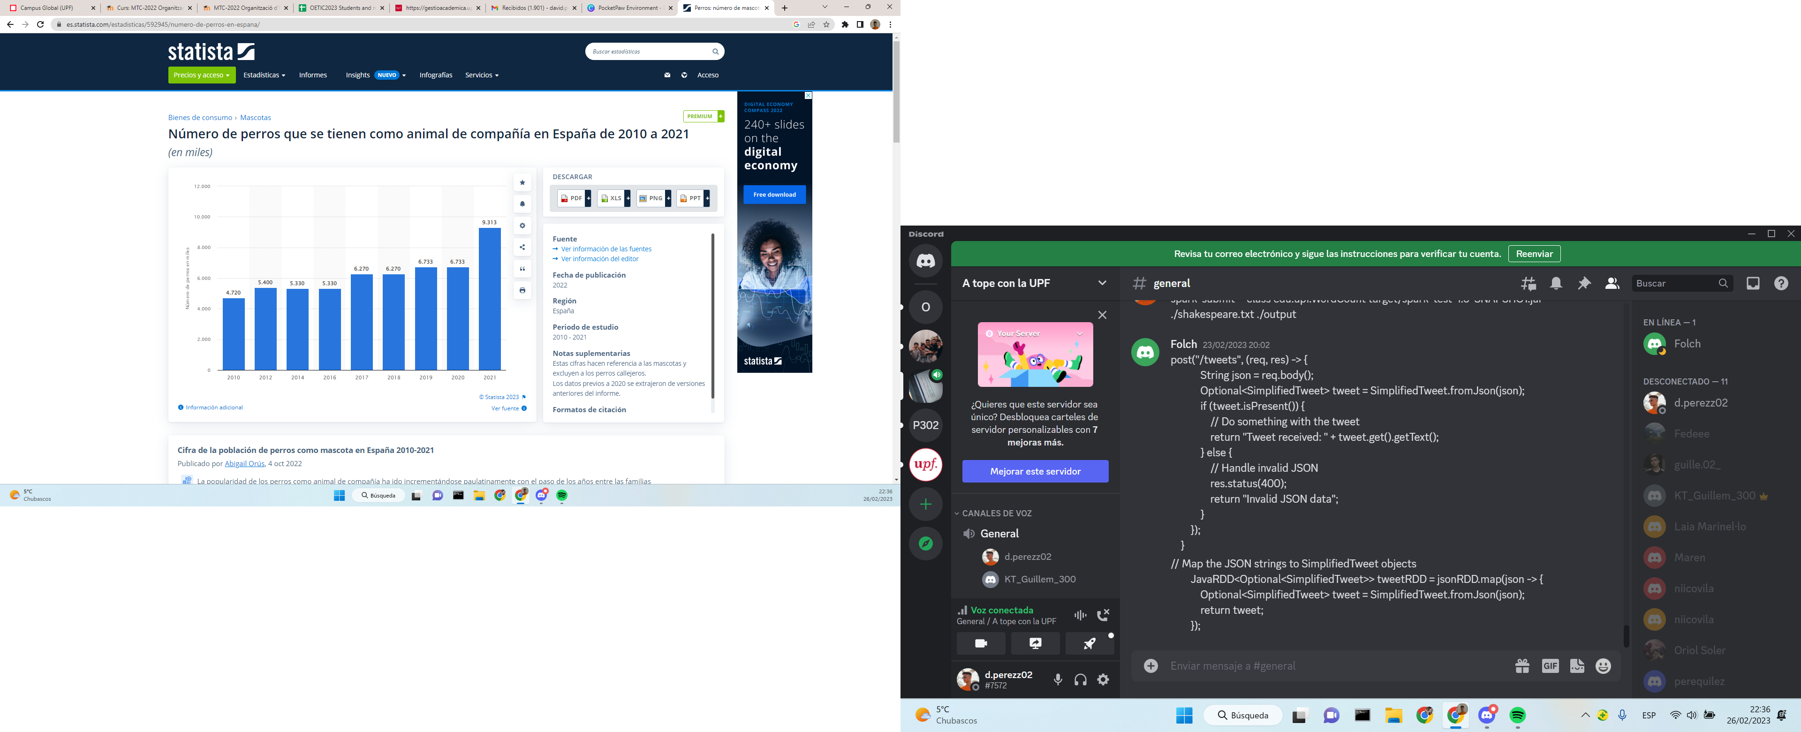

CUSTOMERS
Number of dogs (in thousands)
Moderate growing year by year.
Abrupt increase after Pandemic and lockdown.
-> Post pandemic lives adopted a house
lifestyle, which lead to adopting
more pets.
BACKUP SLIDES
Year
NEW COMPETITORS
High customer leverage: No barriers to switch apps.
Better customer leverage with PRO version: tracker GPS
There is a great oportunity in this sector but it's key to find customers loyalty.
5%
people use an app after 1 month

Slide 45


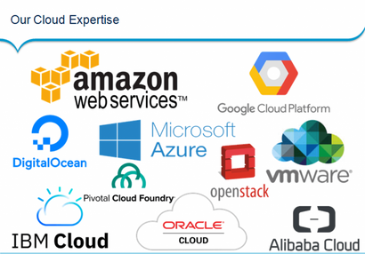

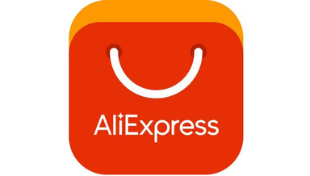

SUPPLIERS
NEW COMPETITORS
There are several GPS manufacturers around the world.
Very competitive pricing, as low as 6$.
Easy to change between suppliers.
High amount of server providers and hosting.
Even if is easy to change between hosting providers we plan to have a long-term contract with them to reduce expenses.
Suppliers have a low negotiation capacity.
Usage of virtual stores such as Google Play or AppStore to provide download facilities of our app. Increments a little negotiation leverage.
We would advertise the app in Google Ads and Social Media like Instagram and Facebook.
It is a growing industry with high demand.
The entry barrier is very low for new competitors. For a initial development and maintenance of a similar service it is estimated an initial investment of 35.000$.
Main difficulty to design a transcendental app with only functional and useful features.
There are some well established competitors that make hard to gain a market share.
In order to let new competitors aside the market we can negotiate with other big players such as Rover.
BACKUP SLIDES

Slide 46

BACKUP SLIDES
Want to know more about our criteria, formulas or parameters used for modelling our previsions?
Is there lack of explanation in any of our accurate previsions?
Something isn't clear enough, or it just doesn't add up?
BACKUP SLIDES
All of our expectations are fully documented and studied, as well as following meaningfull patterns from our study of the market behaviour, you just need to check out our full explanations in our backup slides or in the spreadsheets.

Slide 47
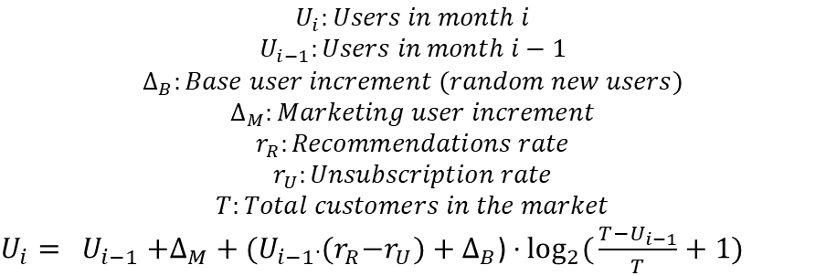
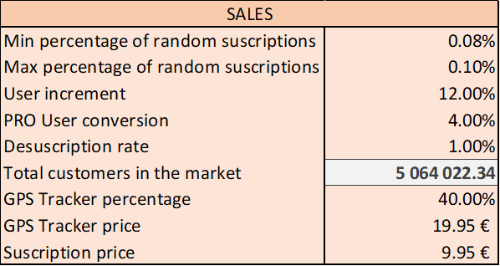
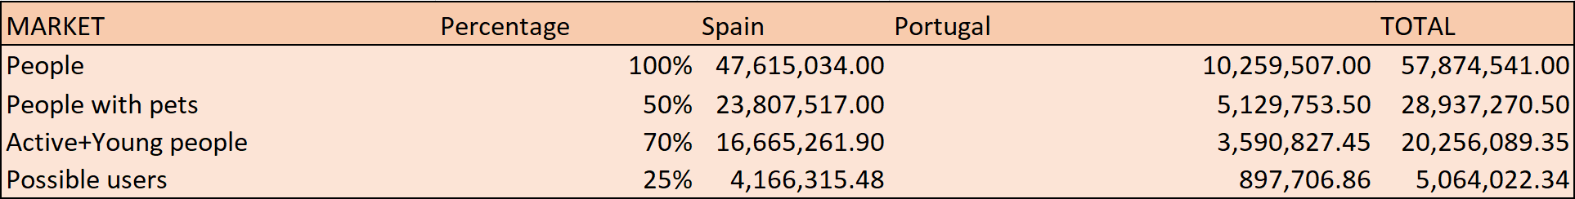
REVENUES - SALES: Users
Users prevision formula:
Parameters:
BACKUP SLIDES
*Further explanation in back up slides
Actual data:

Slide 48

REVENUES - SALES: Users
Our sales mainly consist on the subscriptions and the Tracker units sold, so the PRO version subscriptors are the key.
BACKUP SLIDES
Based on our promotion campagin and a study of the target market users behaviour, we expect the 4% of our users to subscribe to the PRO version.
Company Setup & Product Development

Slide 49
SALES: Users
Why this formula?
BACKUP SLIDES
We consider a random amount of random new users who could end up in our app through not contemplated ways, such finding us through determined searches, randomly finding us in recommended apps, or even by mistake... These are modelled with ∆_B, which is based on a randomly originated number in our spreadsheets, based on two arbitrary bounds and modelled by the remaining target market.

Slide 50
SALES: Users
Why this formula?
After modelling the marketing campaign based on the not reached part of the target market and the annviersaries updates, we expect an increment of users directly dependent on that campaign investment, the ∆_M, concretely the 1% of the target users of each month.
The r_R is another parameter describing the expected rate of users increase from recommendation by existing users, so it has to be dependent on the existing numebr of users (U_i-1) but subsracting from it the expected unsubscribed users, which is another parameter that we expect to be the 1%, after analysing the behaviour of the actual app users in the market.
BACKUP SLIDES

Slide 51
SALES: Users
Why this formula?
That factor that contemplates the probable increase of users independently of our market campaign, (Ui-1*(r_R-r_U)+∆B) is multiplied by a logarithm explicitly studied to smooth that function, whose main goal is to model that growth basing it in the total market too.
T is the total number of users in our target market, so when we have no users increase, that log is gonna return 1 and the formula is gonna return the total number of expected increase users, but while the user increase approaches the number of total potential users, it goes down until reaching 0 when we have reached the total target market( which is very improbable.
In this way, the number of users that we could expect to reach each month, it's now smoothly modelled by our share of the market, making more difficult to reach more customers when we have a bigger share.
BACKUP SLIDES

Slide 52
REVENUES - SALES: Users
Why these parameters?
BACKUP SLIDES
After studying some data in the previous presentation about the users interaction with new apps, we have learnt that close to a 10% of the remaining target market (multiplied by 10000) gets a reasonable amount of new users from not-intentioned or expected sources.
The user increment is the already explained recommendation rate, which we think it's reasonable to be smaller than 15%, but higher than 8%, given the high level of impressions spread throught the users community.

Slide 53
REVENUES - SALES: Users
Why these parameters?
BACKUP SLIDES
As we already said, we expect the 4% of the total users to become PRO users, given the common engagement of internet and APP users in the actual market, and the 40% of these to also buy the GPS.
One could think that the totality of PRO users are gonna buy the GPS Tracker, since it's the main feature from the PRO version, but we, being conservative, have contemplated only the 40% of them, given that the fact of having another expense may prevent the half of them from buying it.

Slide 54
REVENUES - OTHERS
Why these other incomes?
Though our main sales previsions allow us to be optimistic, we expect to need more incomes to keep our company properly running, and we have made a realistic plan based on the actual information.
First, we consider offering an advertising service to other companies, with an average of a 20% of our users opening the app a day, receiving 5 impressions each one of them and charging 1.50€ per 1000 impressions, which is the standard cost in the social media.
We also have the partnership with KIWOKO and the Veterniaries, both of them are billateral, which means not only them promoting our product but we promoting their's and receiving a comission about that.
All the data has been studied from the actual market, for instance the average veterinary cost or the proportion of pet owners going to vet.
BACKUP SLIDES

Slide 55

MARKETING
Why this formula?
BACKUP SLIDES
We want to model how much people do we get from different criteria:
The already share of the market of our company.
The portion of the potential users that we want to reach (initially 10%, increases with the time to reach the rest of the market)
Special campaigns (The initial one and one per each anniversary, when we plan to launch a big update of our app and services).

Slide 56

MARKETING in Data
BACKUP SLIDES
We expect these parameters to be the basis of our marketing modelling, most of them based on current trendencies (real cost of engagement and probable percentage of success ads.

Slide 57



EXPENSES - COWORKING (2%)
BETAHAUS, FROM MONTH 2 >
4.800€/month
BACKUP SLIDES
2x
*We avoid other expenses such as light, water, maintenance...

Slide 58



EXPENSES - SERVERS (2%)
*Includes web domain expenses
BACKUP SLIDES

Slide 59



EXPENSES - DISTRIBUTORS
BACKUP SLIDES
15% of subscriptions and products sales through both App Store and Play Store.

Slide 60


Amortization of computers
BACKUP SLIDES

Slide 61

BP SCHEME - Monthly Income
BACKUP SLIDES

Slide 62

BP SCHEME- Monthly loss
BACKUP SLIDES

Slide 63
WHY YOU SHOULD INVEST?
FAST RECOVERY AND PROFITABILITY
NO STRONG COMPETITOR
Since pet care applications are not a huge market, there are not any competitor that monopolize the market.
Even in the worst case, the recovery and the profit is guaranteed.
BACKUP SLIDES
WELL-STABLISHED BRAND SUPPORT
HIGH MARKET ATTRACTIVNESS
Our partners, KIWOKO are one of the big players of the Pet Care sector so it will help to increase our recognition.
As we have analyzed, the sector is very attractive to a company such as ours.
COMPETITIVE PRICES AND EXTRA FEATURES
MORE THAN ONE SOURCE OF INCOME
PocketPaw provides an All-in-One tool at a very competitive price with some innovative features to differentiate us from our competitors-
PocketPaw is not just a App or a GPS Tracker, it aims to be a whole ecosystem so we will be able to earn money from ads and promotions.

Slide 64

BP SCHEME
BACKUP SLIDES

Slide 65

BP SCHEME
BACKUP SLIDES

Slide 66

BP SCHEME
BACKUP SLIDES

